Slide 1
ESVC21-00011155
National Institute of Technology Jamshedpur
Team Revanta
B-Plan
Electric Solar Vehicle Championship
STATIC ROUND

Slide 2
CONTENT
Business Model Canvas
Executive Summary
Business Description
Our Vision and Mission
Company Hierarchy
Our Prototype’s USP
Basic Plant Layout
Operations Plan
Cash Flow Forecasting
Marketing and Sales Strategy
Competitive Analysis
Financial Plan
Break Even Analysis

Slide 3









Business Model Canvas for Revanta
Comprehensive business model to demonstrate our prototype and show that it is a rewarding business opportunity.
Key Partners Buyer-Supplier: Auto parts dealers Electrical and electronics dealers Raw material dealers Strategic Alliance: Cab Service Providers Tourism Agencies
Key Activities Manufacturing solar panels Manufacturing Electric Vehicles
Key Resources Production Plant Engineers & Technical staff Partnerships
Customer Relationships Finest after-sales services
Channels One Level Channel Manufacturer->Retailer->Consumer
Customer Segments Environmental Lovers Technology Oriented Early Adopters All income levels Market Segment: Recreational Spots Tourist destinations Cab Service Providers
Value Propositions Extremely safe Very comfortable Cost efficient Affordable Eco-friendly Self Charging Make in India by India Low Maintenance
Cost Structure Raw Materials Plant-Set up Equipments Labour | Revenue Streams Sales of Solar- Electric Vehicles Promotions or Advertisements
Advertisement
Research & Development

Slide 4

Executive Summary
The World is changing…
So why not we!!!
Revanta Pvt. Ltd. will be a Jamshedpur-based solar electric vehicle manufacturing company. Our vision is to tap into the potential of electric four-wheeler market of India.
WE PASSIONATELY OWN OUR VISION AND WORK DEVOTEDLY TO DRIVE IT TO REALITY.
The Indian Electric Vehicle Market was valued at USD 5 billion in 2020, and it is expected to reach USD 47 billion by 2026, registering a CAGR of above 44% during the forecast period (2021-2026). Source:Economic Times
However, India’s share of investment in e-mobility is largely confined to the two-wheeler segment.
Hence, we plan to leverage the four-wheeler market, with our highly efficient, supremely competent in safety and performance, and eco-friendly car in the most affordable price in the market.
Hence, we expect a positive cash flow increase at a significant rate with expected profit of more than 30 lakhs in our very first year.

Slide 5

Vision
To lead the world towards more sustainable and clean energy and ensure a greener tomorrow.
Mission
To become the leader in the electric vehicle sector with cutting edge technology, innovative solutions and futuristic developments
To be the customer’s first choice in safety and comfort through innovation and quality excellence
Devoted towards turning our Vision and Mission into Reality.

Slide 6
Company Hierarchy
Chief Executive Officer
Chief Finance Officer
Director of Manufacturing
Director of Operations
Director of Business Development
Finance Manager
General Manager
Production Manager
Plant Manager
Operations Manager
Marketing & Sales Head
Senior Accountant
Sales Staff

Slide 7
Our USP
We don't just make cars we also make future greener with our electric-solar eco-friendly vehicle.
Unique Selling Proposition
Make in India.
More Aerodynamic and smarter look
01
Superior Performance
05
Low Maintenance
We came with something special this time
02
Compact Size and easy handling
06
Affordable
03
07
Reduced camber variation to improve cornering
Innovated an Auto positioning solar panel system that will increase the efficiency.
Superior Mileage
Extraordinarily safe and comfortable
04
Highly Automatic: Remote Control
08
Ease manoeuvrability

Slide 8
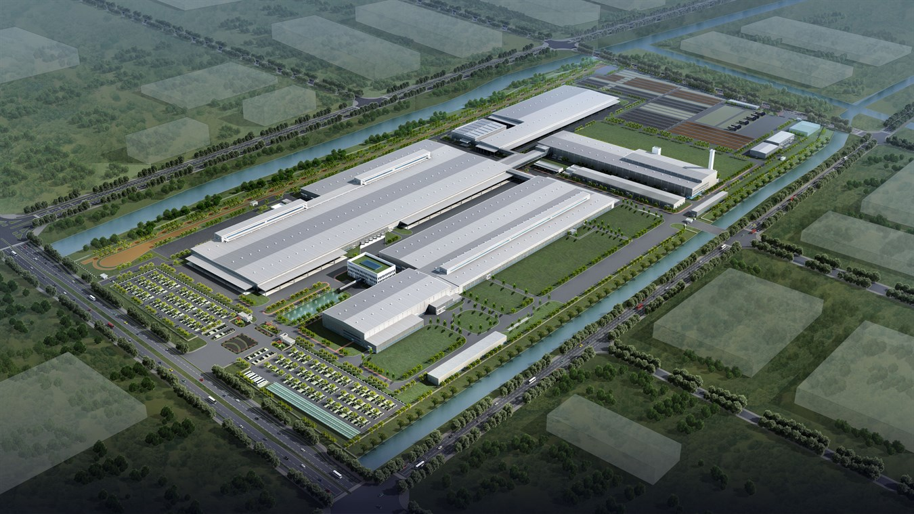
Basic Plant Layout
Design and Analysis
Solar Panels
Manufacturing
Brake+Suspension+Steering+Wheel
Mounting
Fabrication
R&D
Motor and Controller

Slide 9
Line Layout
⟰
Workstations
Departments
⟰: Research and development
1: Design and Analysis
2: Manufacturing
3: Brakes+Wheels+Suspension+Steering
4: Mountings
5: Motor and Controller
6: Solar Panels
7: Fabrication
1
2
3
6
5
4
7

Slide 10
Operations Plan

Slide 11
Cash Flow Forecasting
To Project 6 Months Cash position of the company
Units Sale and Cash Inflow forecast
MONTHS | JANUARY | FEBRUARY | MARCH | APRIL | MAY | JUNE
SALES | 100 | 200 | 350 | 550 | 800 | 1100
PRICE PER UNIT(INR) | Rs 179550 | Rs 179550 | Rs 179550 | Rs 179550 | Rs 179550 | Rs 179550
CASH INFLOW
CAR SALES | Rs 17955300 | Rs 35910600 | Rs 62843550 | Rs 98754150 | Rs 143642400 | Rs 197508300
OTHERS | Rs 10000 | Rs 15000 | Rs 18000 | Rs 20000 | Rs 25000 | Rs 26000
TOTAL | Rs 17965300 | Rs 35925600 | Rs 62861550 | Rs 98774150 | Rs 143667400 | Rs 197534300

Slide 12
Cash Outflow Forecast
MONTHS | JANUARY | FEBRUARY | MARCH | APRIL | MAY | JUNE
CASH OUTFLOW
MACHINERY(RAW MATERIALS+AUTOPARTS) | Rs 15544000 | Rs 31088000 | Rs 54404000 | Rs 85492000 | Rs 124352000 | Rs 170984000
TAX | Rs 1398960 | Rs 2797920 | Rs 4896360 | Rs 7694280 | Rs 11191680 | Rs 15388560
LABOUR | Rs 932640 | Rs 1865280 | Rs 3264240 | Rs 5129520 | Rs 7461120 | Rs 10259040
RESEARCH AND DEVELOPMENT | Rs 10000 | Rs 10000 | Rs 10000 | Rs 10000 | Rs 10000 | Rs 10000
ADVERTISEMENT | Rs 5000 | Rs 5000 | Rs 5000 | Rs 5000 | Rs 5000 | Rs 5000
TOTAL | Rs 17890600 | Rs 35766200 | Rs 62579600 | Rs 98330800 | Rs 143019800 | Rs 196646600

Slide 13
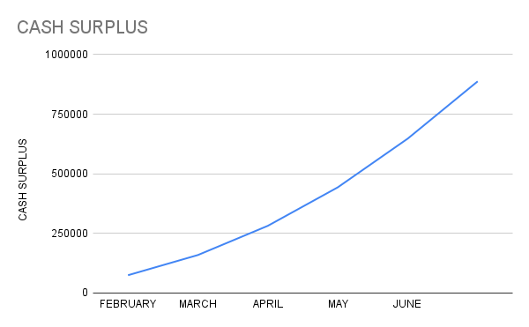
MONTHS | JANUARY | FEBRUARY | MARCH | APRIL | MAY | JUNE
TOTAL CASH INFLOW(INR) | 17965300 | 35925600 | 62861550 | 98774150 | 143667400 | 197534300
TOTAL CASH OUTFLOW(INR) | 17890600 | 35766200 | 62579600 | 98330800 | 143019800 | 196646600
CASH SURPLUS(INR) | 74700 | 159400 | 281950 | 443350 | 647600 | 887700
We have a strong, positive cash Flow forecast.
The cash surplus graph is rising with a positive slope suggesting a promising profitable company with “high quality” Net Income.
Expected cash surplus of more than 30 lakhs at the end of first year.

Slide 14
Marketing And Sales Strategy

Slide 15
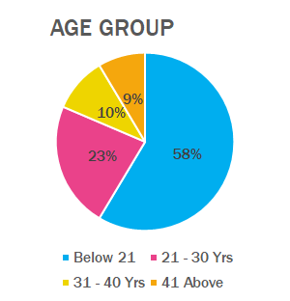
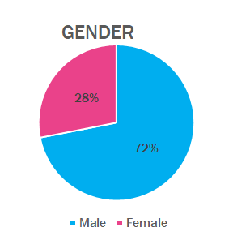
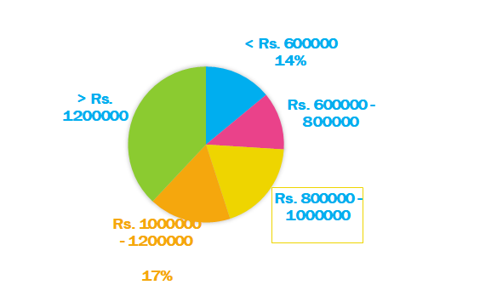
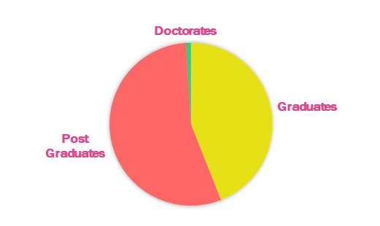
Market Survey
Annual Family Income
Educational Qualification

Slide 16
Insights from Market Research
This Research identified our major Target markets and Target customers.
We divided our target customers into 4 segments :
1
Active Environmental Segment
2
Technology- Oriented Segment
3
Early Adopters
4
Money Saving segment
Our Target Markets could be:
1
Recreational Spots like zoos, amusements parks etc
2
Major Tourists destinations like Delhi, Mumbai etc
3
Nature-based tourism spots like National Park and Wildlife sanctuaries etc
4
Collaborating with Cab service providers

Slide 17
Strategies to maximise our sales
India boasts 104 national parks, 551 Wildlife Sanctuary and 1000+ other famous Nature-based tourism spots like himalayas, coastal spots, biospheres and many others in India. India is a major tourism destination for various types of tourisms.
Be it jungle safari, site seeing or commuting we plan to target 10% of the tourist agencies in all these places.
On an average, there are more than 10 agencies in each of these tourism spots(=1000+). Targeting 10% of these customers agencies in our first year and selling at least 2 cars each.
= 10*1000*0.1*2 =2000
Total Sales made in first year from this market= 2000
Making them our permanent customers and slowly replacing all diesel and petrol cars/safaris with EVs
In the subsequent years targeting more such cities and agencies
Major Tourists destinations and nature-based tourist destinations
Zero-Emission
Environment Friendly
Safer for Roads as reduces accidents : Perfect for highly populated tourist spots
Low Noise
Cheaper
Low maintenance
Notes:
People who organise jungle safaris in wildlife sanctuaries and national parks will prefer our car as it low on noise with a solar hybrid technology which can either be charged or can be run on solar power minimizing the pollution.
Adding to it, the chances of spotting a big cat will be more as there will be no diesel engine to announce the approach of a safari vehicle.
The cost efficient electric vehicle available in the market.

Slide 18
Targeting Moderate Income level customers in small towns and villages
For low and middle income customers it is a privilege to own a car combined with increasing petrol and diesel prices, owning a car becomes a fortune. Revanta Pvt. Ltd. provides an excellent benefit to this customer segment.
There are more than 8000 small towns, 630,000 villages in India.
Targeting 0.1% of the small towns and villages in our first year and selling at least 5 cars per town/village we can sell:
= 8000*0.001*5+630,000*0.001*5
= 40+3150
= 3,190
Hence, we can sell 3,190 cars in our very first year in this target market.
2.
Cost-Efficient : saves money and resources
Low maintenance
Self-charging
Excellent after sales services
Affordable : cheapest yet safest in the market

Slide 19
A similar estimation for the rest of the target markets shows Revanta Pvt. Ltd. has the potential to sell more than 10 thousand Solar Electric cars per year starting from the very first year and increasing there on.
Revanta Pvt. Ltd. has a promising growth potential and has full possibility to become a rewarding business opportunity.

Slide 20
COMPETITIVE ANALYSIS

Slide 21
Analysing the leading EV manufacturers in India
MAHINDRA ELECTRICS TATA MOTORS
WEAKNESS:
Experts say by launching an electric variant in the personal space of the existing not-so successful models has not worked for Mahindra.
EV adoption was throttled because of 5 major barriers -- unavailability of options, range anxiety, unavailability of charging infra, unavailability of financing from banks and economic viability.​
WEAKNESS:
The Delhi government’s decision to delist Nexon EV and the rising number of issues in the electric vehicles available in India have raised questions about their efficacy and viability
Senior government officials have refused to use electric cars made by Tata Motors Ltd citing poor performance and low mileage.​
STRENGTH:
Scalability advantage for Mahindra, as they make products from three-wheelers to buses. .
Amazon and Flipkart collaborated with Mahindra Electric.
STRENGTH:
A decent performance of its cars and assurances such as an 8 year (or 1.6 lakh km) warranty on battery and motor.
Partnered with TATA Power to provide fast charging stations in key cities and offering free home charging facility with every Nexon EV sold.

Slide 22
A comparison of our Vehicle
 | Revanta Lankensperger | Mahindra E Verito | Tata Tigor EV
Body style | Rear wheel drive, with four wheel | Front wheel drive, with four wheel | Front wheel drive, with four wheel
Battery | 80Ah 51.8V LI-ion battery | 288Ah Li-Ion battery | 26kWh Li-Ion battery
Motor | BLDC Motor | 3 Phase AC induction Motor | Permanent Magnet Synchronous Motor
Top speed | 45 Kmph | 80 Kmph | 120 Kmph
Charging time | 5.33 Hour | 11.5 Hour | 8 Hours
Weight | 262 Kg | 1265 Kg | 1235 Kg
Price | Rs. 1,73,690 | Rs. 10,15,000 | Rs. 11,99,000

Slide 23
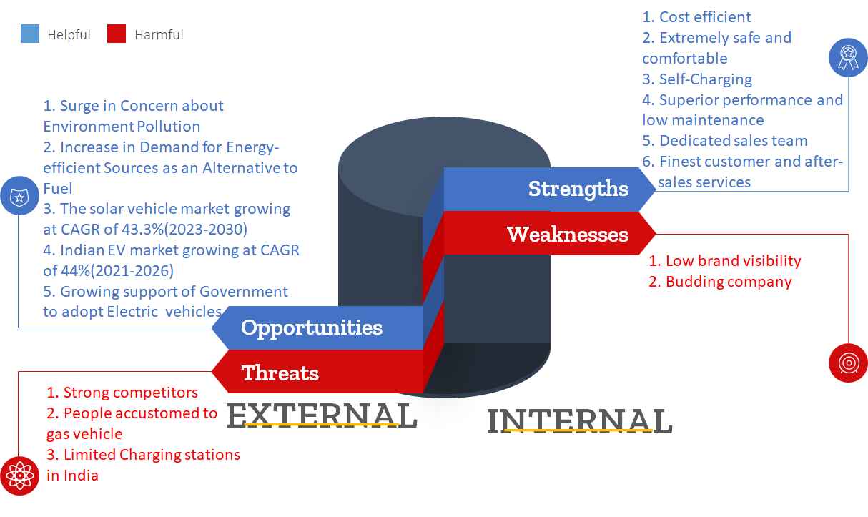
SWOT ANALYSIS of
Revanta’s Lankensperger
Notes:
Technical customer service, since new technology

Slide 24
FINANCIAL PLANNING

Slide 25
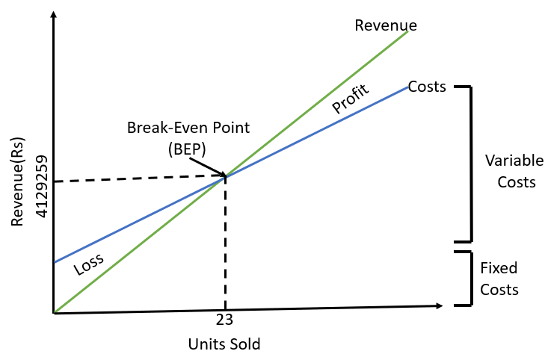
Break Even Analysis
Total Fixed Cost per month : Rs 3,75,000
( initial plant set-up cost+R&D+Advertisements)
Variable Cost per unit : 1,63,212
( raw materials+auto parts+sales tax+labour)
Price per unit : Cost + 3% Profit Margin = 179550
BEP= Total Fixed Cost/ ( price per unit-variable cost per unit)
= 375000/( 179550-163212)
= 23
Notes:
Consider outsourcing product assembly and other operations to reduce your expenses.
Assess your financing options, including bank loans, lines of credit and private investors .

Slide 26
THANK YOU

